Slide 1
PreMiEr REU Bootcamp
June 7th
Anthony Fodor
UNC Charlotte
afodor@charlotte.edu

Slide 2
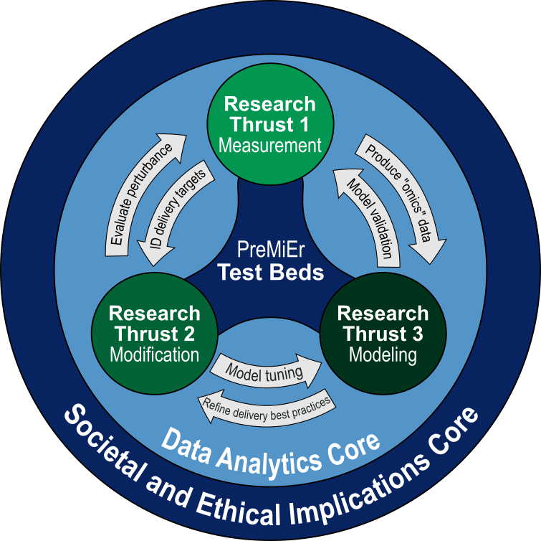
Structure of PreMiEr Convergent Research (CR)
PreMiEr’s CR foundation comprises six essential components:
Research Thrusts
Research Thrust 1 (RT1)
“Measurement”
Research Thrust 2 (RT2)
“Modification”
Research Thrust 3 (RT3)
“Modeling”
Research Cores
Data Analytics (DA)
Societal & Ethical Implications (SEI)
PreMiEr Test beds
Environmental Chambers, Artificial Gut Bioreactors, PreMiEr Home @ Duke, Hospitals, PreMiEr Communities
PreMiEr Site Visit (May 30th, 2024)
DA Contacts: Anthony Fodor (afodor@charlotte.edu)
Ivory Blakley (ieclabau@charlotte.edu )
PreMiEr Year 1 Annual Report, see pages:
Research Thrust Overviews: 76-77
Thrust/Core Highlights: 108-149

Slide 3
Recommendations for dealing with contaminant issues in
built-environment sampling
Anthony Fodor
UNC Charlotte

Slide 4
Even without contaminants, microbiome sampling is complex…
Issues with compositionality and measurement bias can impact the accuracy of our measurements
(and there is an extensive literature on these issues…)
Contamination is another level of complexity that is especially problematic in low biomass samples
(i.e. most of the sampling we will do in the built environment).
Consider for each taxa (ignoring bias), the “observed” and “actual” values for a taxa
Observed = present in sample + sum( contaminant)
In high biomass samples, the observed will be highly correlated to the observed
In low biomass samples, contaminants may dominate

Slide 5
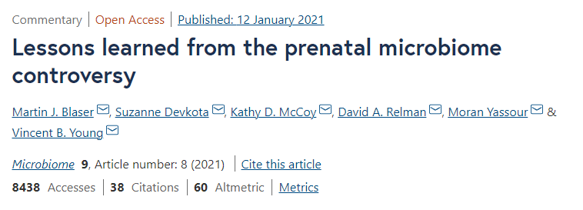
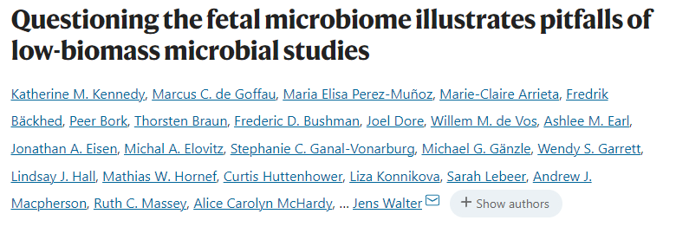
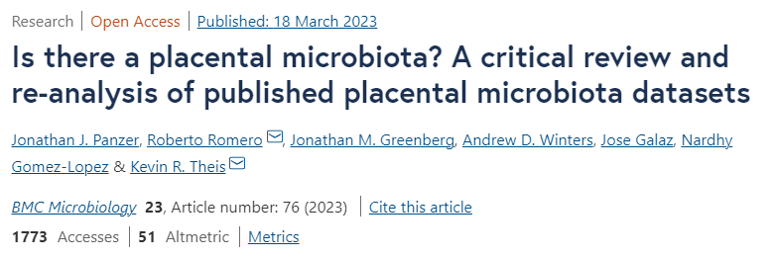
Measuring low abundance microbiome is difficult and can lead to ambiguous results
The “placental microbiome” controversy has consumed a great deal of time and effort
A consensus appears to be emerging that these studies can be largely explained by contaminant
In PreMiEr, we will need very strong evidence for assertions we will make about low biomass environments

Slide 6
Removing contaminants from microbiomes is complex.
There is no simple strategy that will work consistently across different experimental strategies
or even consistently within a single pipeline.
So instead of a simple list of rules to follow that will always “solve” the problem, we are instead
forced to list a series of questions you need to ask about your study you need to think about as
you plan your sampling.
Like so much else in the center, a strategy for contaminant detection in your study will likely be
iterative requiring many cycles of trial and error.
Our goal is compelling evidence that our conclusions cannot be explained by contaminant

Slide 7
Q1: What is the purpose of my experiments?
Am I trying to do biology (where I want to just remove all the contaminants)
or pipeline development (where I want to understand the source of contaminants)?
This impacts the design of your negative controls.

Slide 8
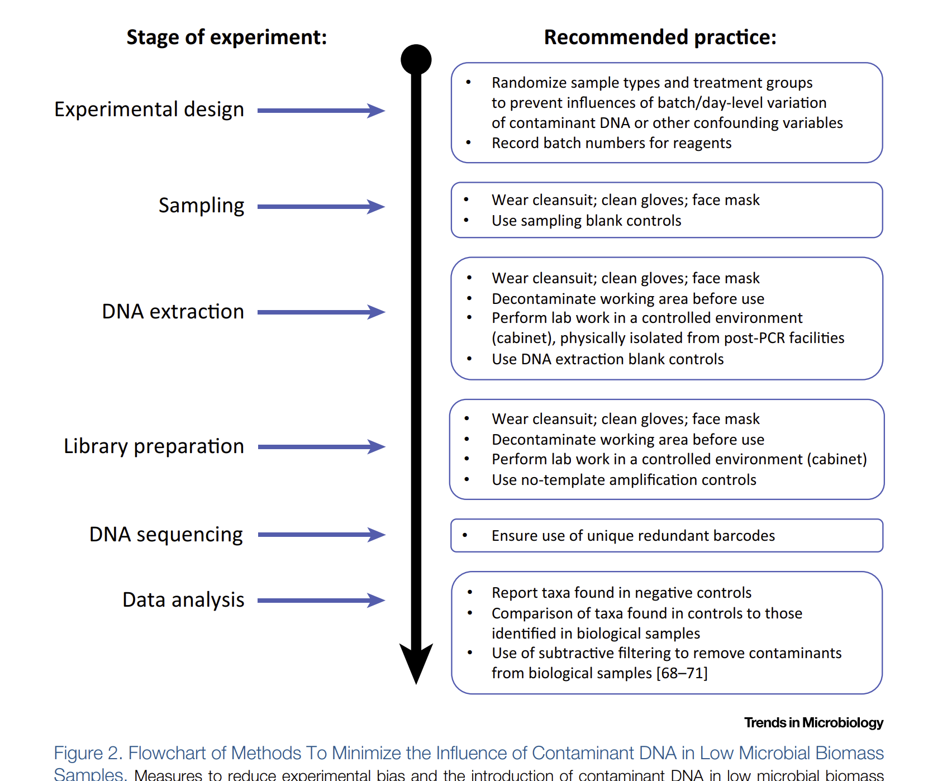
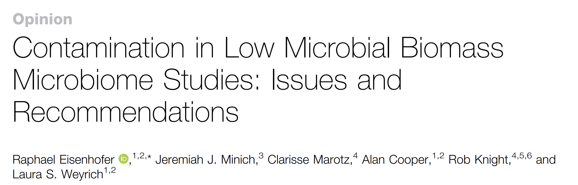
This base document from 2019 is
a good place to start in terms of
wet lab recommendations
Feb 2019

Slide 9
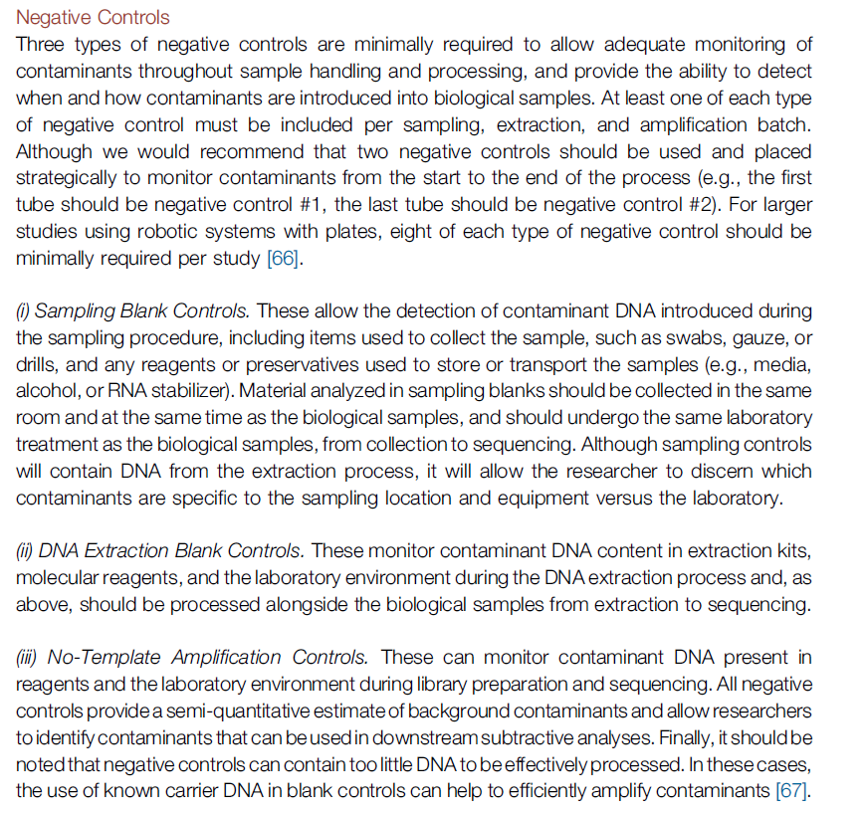
From Dr. Callahan:
Not all controls are created equal.
Controls at the beginning of an experiment
have more power for contaminant detection.
Controls at each step have more power in
resolving the source of a contaminant.

Slide 10
Q1: What is the purpose of my experiments?
Am I trying to do biology (where I want to just remove all the contaminants)
or pipeline development (where I want to understand the source of contaminants)?
This impacts the design of your negative controls.
Q2: How much do I care about establishing the limits of detection and cross-contamination?
This impacts the design of your positive controls.

Slide 11
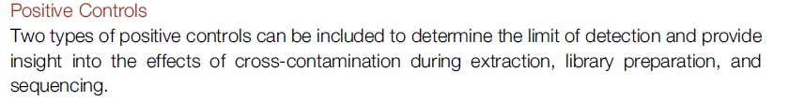
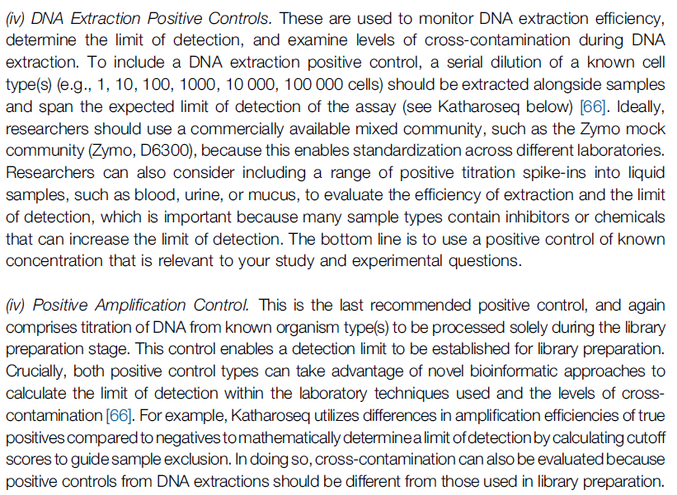
Are positive controls worth
the sequencing effort?
In general, we want to avoid
placing a high-abundance control
in an otherwise low-abundance
pipeline
The “correct” number of positive
controls may be 0-1 for some of our
experiments

Slide 12
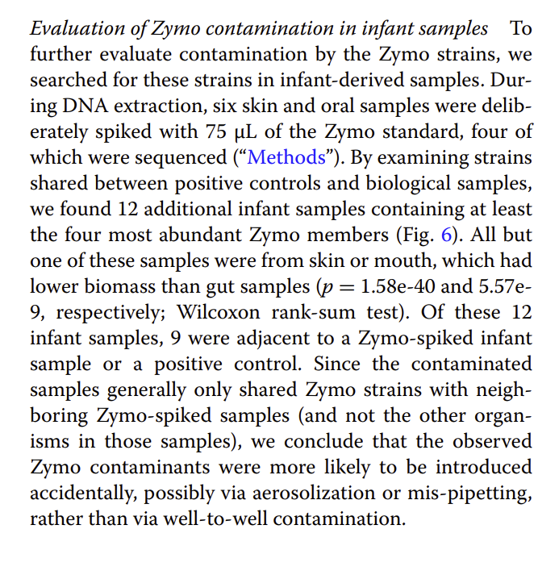
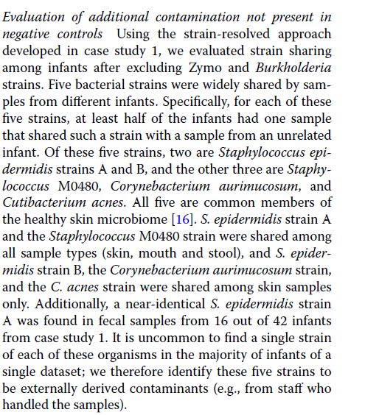
Positive controls and technician skin microbiome are also sources of contaminant in Lou et al

Slide 13
Q1: What is the purpose of my experiments?
Am I trying to do biology (where I want to just remove all the contaminants)
or pipeline development (where I want to understand the source of contaminants)?
This impacts the design of your negative controls.
Q2: How much do I care about establishing the limits of detection and cross-contamination?
This impacts the design of your positive controls.
(I think an argument could be made for a technician skin sample positive control)

Slide 14
Q1: What is the purpose of my experiments?
Am I trying to do biology (where I want to just remove all the contaminants)
or pipeline development (where I want to understand the source of contaminants)?
This impacts the design of your negative controls.
Q2: How much do I care about establishing the limits of detection and cross-contamination?
This impacts the design of your positive controls.
(I think an argument could be made for a technician skin sample positive control)
Q3: How much would cross-contamination of samples complicate interpretation of
experimental results?

Slide 15
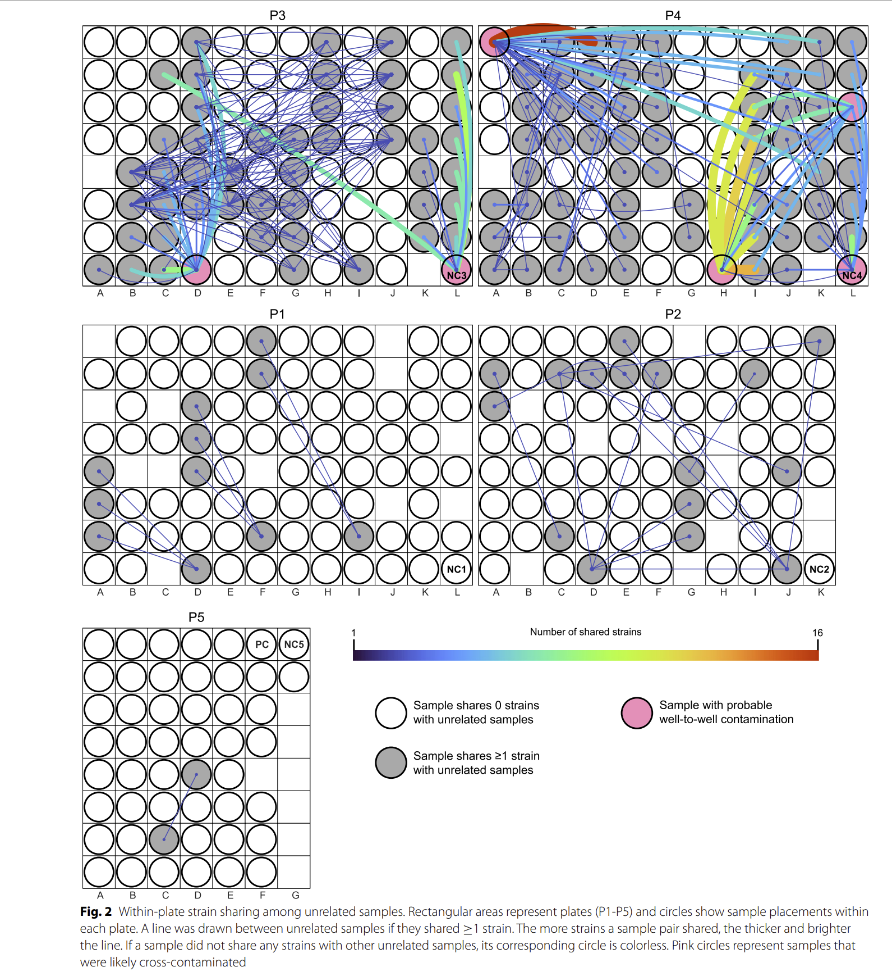
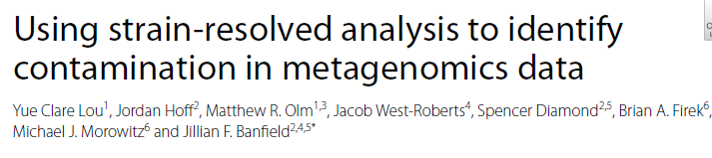
In Lou et al, this is a map describing most likely cross-sample contaminant on 96 well plates
Cross-contamination is widespread,
especially if 96 well plate automation is used.

Slide 16
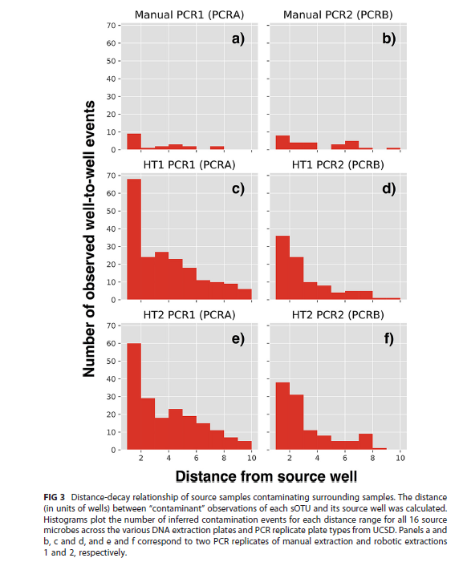
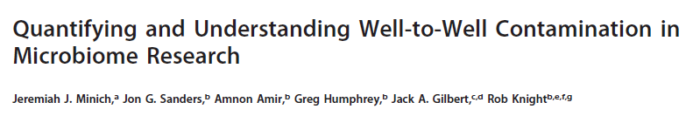
Well to well contamination was explicitly studied in 2019
Manual extraction shows much less well-to-well contamination than high-throughput extraction

Slide 17
Q1: What is the purpose of my experiments?
Am I trying to do biology (where I want to just remove all the contaminants)
or pipeline development (where I want to understand the source of contaminants)?
This impacts the design of your negative controls.
Q2: How much do I care about establishing the limits of detection and cross-contamination?
This impacts the design of your positive controls.
(I think an argument could be made for a technician skin sample positive control)
Q3: How much would cross-contamination of samples complicate interpretation of
experimental results?
Re-extraction of samples from a different randomized context and
avoiding automation may minimize cross-contamination but with obvious costs

Slide 18
Source | Is clearly contaminant | Can be addressed with database searches | Can be solved with long-read requirements | Can be addressed algorithmically | Implications for inference
Non-biological contaminant (e.g. kit contaminant) | Yes. Using a different kit will produce different results. | Probably (especially if a kit has been used in many previous experiments) | Possibly | Possibly (contaminants should be about equally present in all samples irrespective of metadata) | When comparing samples of similar biomass, spurious results are unlikely to be produced.
Biological contaminant (e.g. skin contaminant) | Unclear. If you send a researcher into the built environment, the environment changes. But is that contaminant? Like electrons, measuring the built environment will change the built environment | Possibly (but each person has a distinct skin microbiome!) | No | Possibly (contaminants should be equally present in all samples, but depends on when in the process samples were exposed to human microbiome) | When comparing samples of similar biomass, spurious results are unlikely to be produced.
Cross-samples contaminant | Yes. | No (since each experiment is likely to have unique taxa) | No | Possibly but only if all batch information (including well location) is recorded | Minimal if all blocks (including well) are randomized

Slide 19
Recommendations that are (presumably) not controversial:
Make your lab procedures as clean as possible
Use dual-indexed non redundant bar codes
Measure biomass of samples
Randomize as much as possible across inference categories.
Record all possible batches
(technicians, plate, well position, date of extraction,
sequencing runs, well position)

Slide 20
More “difficult” decisions:
What kind (and how many) negative controls to run.
Obviously, more negative controls for lower biomass samples!

Slide 21
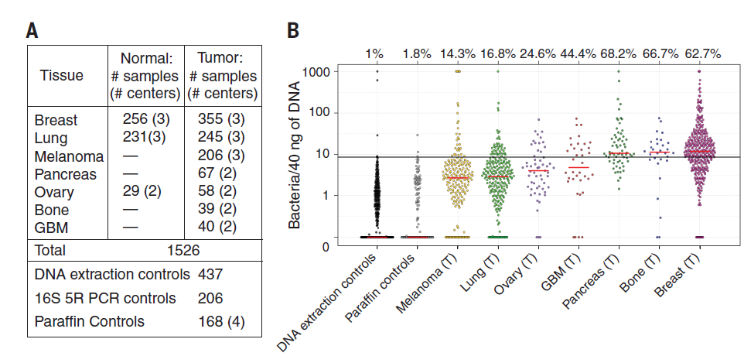
The dataset used for validation of SCRuB is one we should study for how to do low biomass sampling.
They had 811 negative controls for ~1500 samples.
We could consider a similar fraction of effort for negative controls
The human tumor microbiome is composed of tumor type–specific intracellular bacteria. Science. 2020

Slide 22
More “difficult” decisions:
What kind (and how many) negative controls to run.
Obviously, more negative controls for lower biomass samples!
Starting with as much as 0.5 negative controls per sample
and scaling back after initial successes seems reasonable for
ultra-low biomass samples.

Slide 23
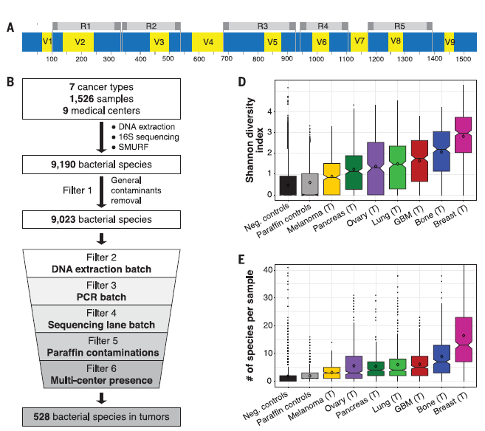
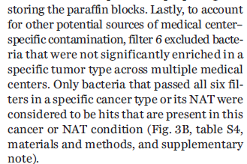
This is a convincing pipeline that I argue we could consider as a model….
They used data from 5 different amplicons.
This is something we probably should adopt.
May be much more feasible than WGS on
low-abundance samples and much more
rigorous than single amplicon 16S sequencing
The last filter is a multi-center inference filter
The human tumor microbiome is composed of tumor type–specific intracellular bacteria. Science. 2020

Slide 24
More “difficult” decisions:
What kind (and how many) negative controls to run.
Obviously, more negative controls for lower biomass samples!
Starting with as much as 0.5 negative controls per sample
and scaling back after initial successes seems reasonable for
ultra-low biomass samples.
How much to avoid automation to avoid cross contamination?
How much to avoid high abundance samples (including positive controls)?
How much to re-extract across different random contexts
(to minimize cross-contamination)
What kind of sequencing to do? Single amplicon? Multi-amplicon? WGS?

Slide 25
How will we analyze these data?
No “black box” solution that will work for every experiment.
We don’t know what fraction of our built environment samples will be contaminant
(but it will presumably be pretty high).
Algorithms designed for other environments may not work well for our data.

Slide 26
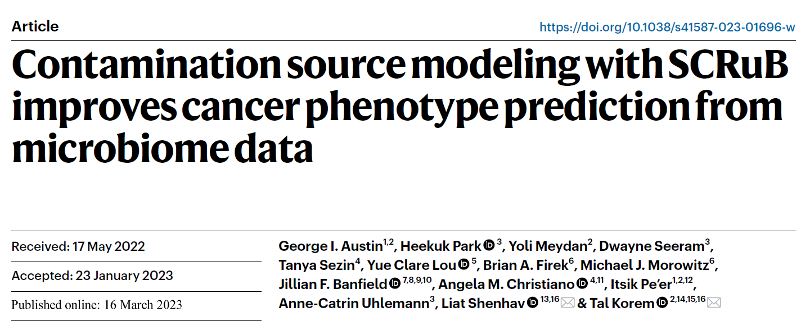
March, 2023

Slide 27
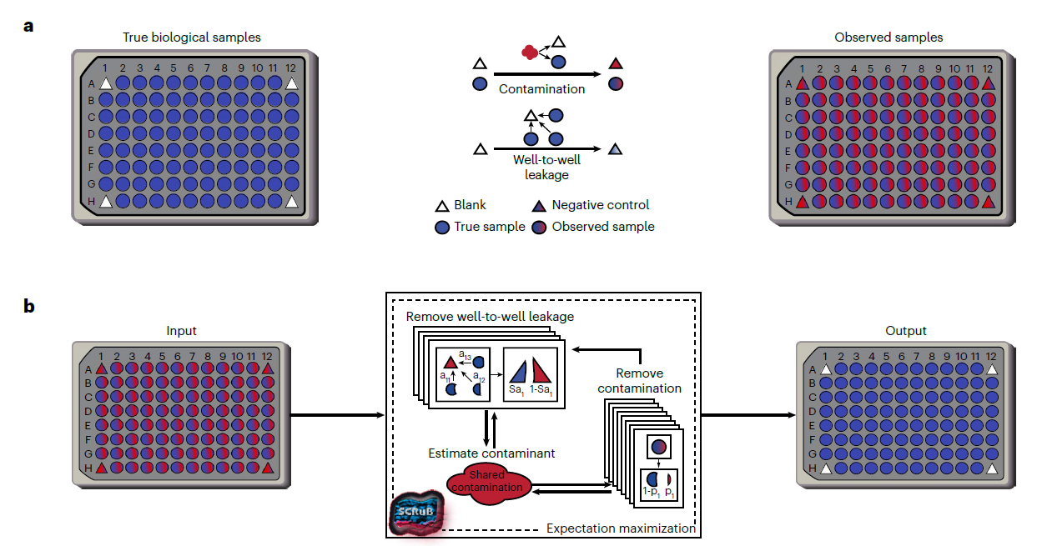
In terms of analytics, SCRuB (published March, 2023) attempts to explicitly model and correct for
sources of contamination
Contamination source modeling with SCRuB improves cancer phenotype prediction from microbiome data.
Nature Biotechnology

Slide 28
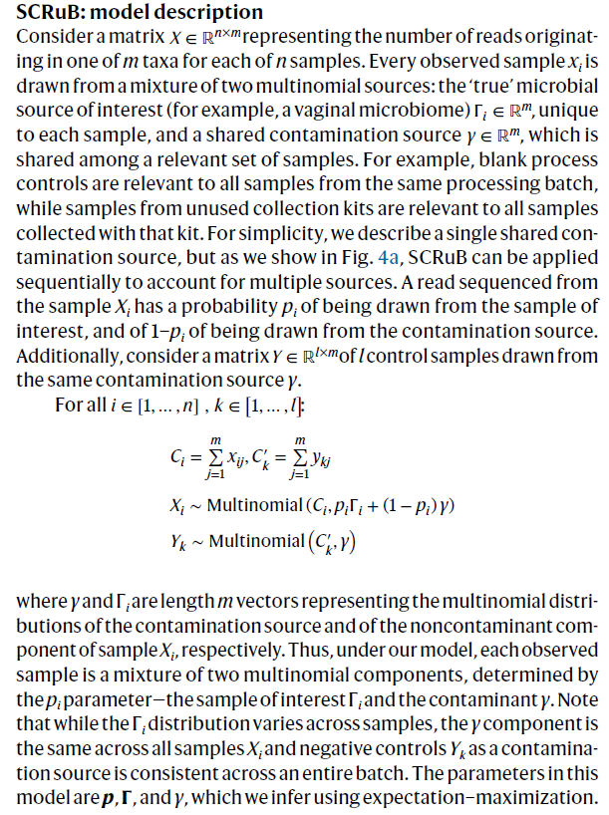
SCRuB assumes a constant contaminant
contribution and a variable “signal”,
models everything with the multinomial distribution
And finds parameters by expectation maximization

Slide 29
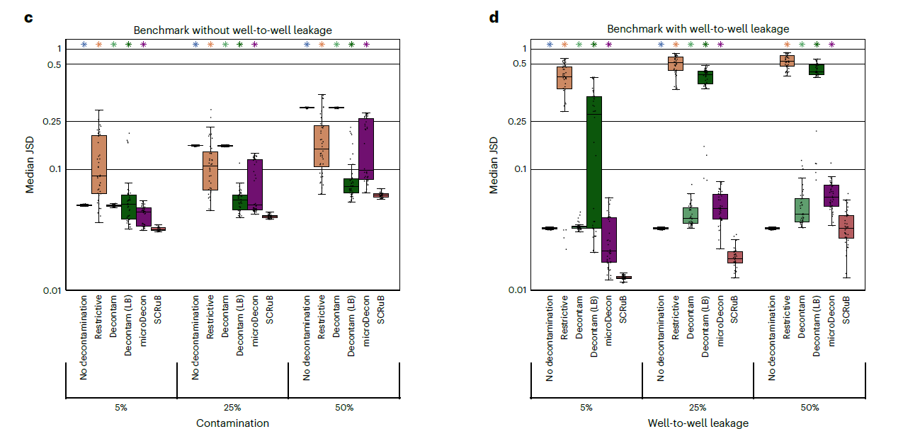
The authors generate simulated datasets to show off their algorithm
Contamination source modeling with SCRuB improves cancer phenotype prediction from microbiome data.
Nature Biotechnology

Slide 30
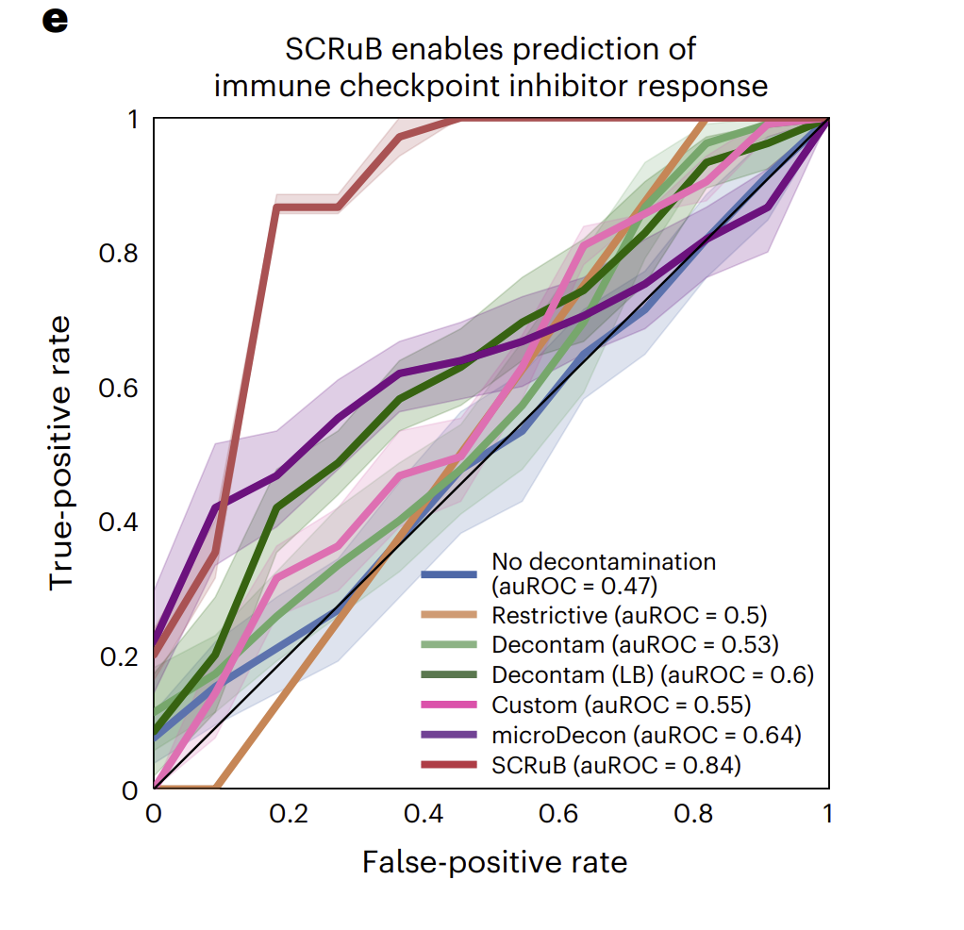
But what puts this paper into Nature Biotechnology is this startling result re-analyzing a
(low biomass) tumor experiment (predicting from n=73 from one center to modest n=18 from a different continent)
This is impressive, but this result is dependent
on correct classification of only ~6-8 samples
over competing methods
Contamination source modeling with SCRuB improves cancer phenotype prediction from microbiome data.
Nature Biotechnology

Slide 31
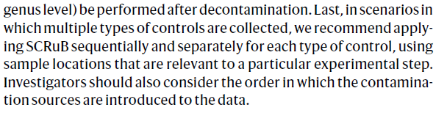
SCRuB does have some limitations. It can only deal with one source of contaminant at a time…
The concluding paragraph
There is room for further analytical development allowing for simultaneous input
of multiple contaminant sources

Slide 32
Areas of future research we should consider for our center:
(1) How robust are the machine learning gains shown by SCRuB?
Can we find other datasets in which removal of contaminant improves ML performance? Or does the fact that SCRuB only shows a dramatic increase
in a validation set with a small sample size suggest that gains in inference and ML
will be modest with contaminant removal.
(If contaminants are properly randomized, inference should be safe)
(2) Can we extend SCRuB to deal with multiple sources of contaminant simultaneously?
How much does the order in which contaminants are removed matter for results?
(3) Using skin and kit microbiome as references together with the expectation
that contaminant will be independent of metadata, how much of existing
public datasets (Sloan Foundation, metaSub, low abundance HMP, other
environmental datasets) can be explained as contaminant?

Slide 33
Avoiding over-fitting in multiple-hypothesis testing experimental designs.

Slide 34
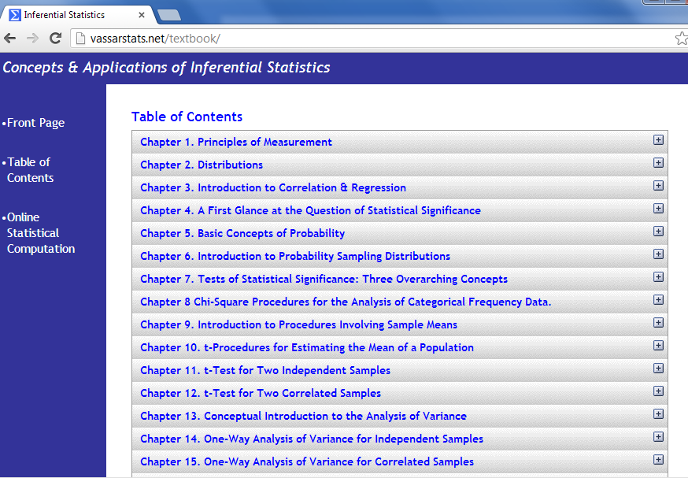
On-line resources:
Vassar stats book
http://vassarstats.net/textbook/
You will need at least one book that covers canonical statistics.
Start with this one (it is free) and then if it is not working for you, consider alternatives…

Slide 35

https://diytranscriptomics.com/Reading/files/The%20Art%20of%20R%20Programming.pdf

Slide 36
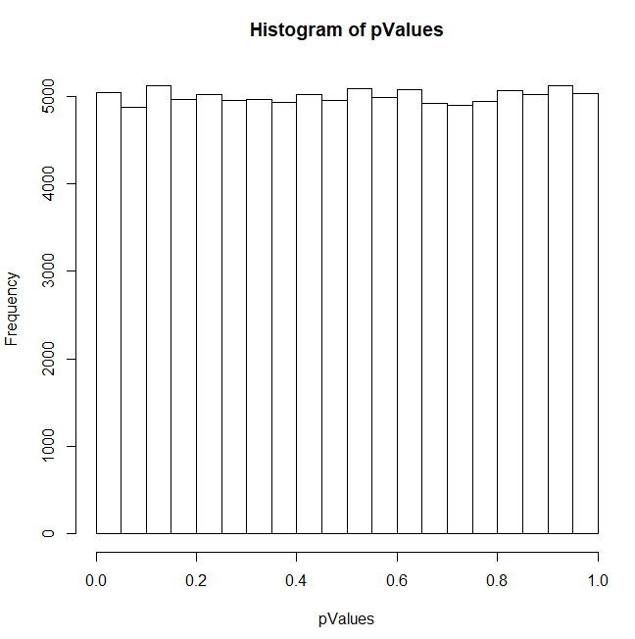
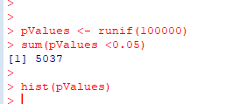
The histogram of all p-value is uniform when the null hypothesis is expected to be true!
Simulate an experiment where the null
hypothesis is always true…
Don’t use simple thresholds of p <0.05 for cases where you have evaluate multiple hypotheses!

Slide 37
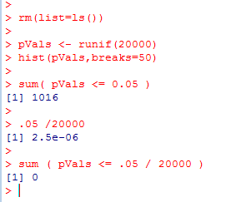
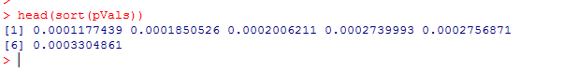
One alternative:
Use as a p-value threshold Bonferroni correction.
The desired threshold / number of tests.
In this case 0.05 / 20000 = 2.5e-06
None of our p-vals reach this threshold..
At this threshold, there is a 5% chance of any false positives

Slide 38
Bonferroni correction is sometimes considered too conservative for genomics experiments.
At small sample sizes, you might have few genes with p-values smaller than the
Bonferroni thresholds.
A less conservative alternative, false discovery rate.
At a 5% false discovery rate, we expect 5% of our hits to be false positives.
This is less conservative than Bonferroni correction, where there is a 5% chance
that any of our hits are false positives.

Slide 39
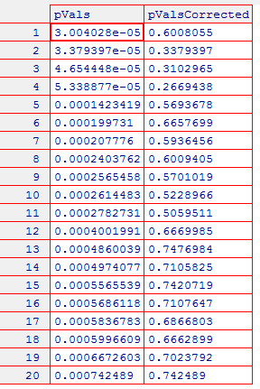
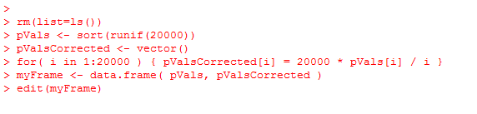
One straight-forward approach to finding genes at a given false-discovery rate
Benjamini and Hochberg FDR
1. Rank all the p-values (smallest first). The rank of each value = K
2. Calculate N * p / k
where N = the # of hypotheses that you are testing
p = the “raw” (uncorrected) p-value.
3. Start at the top of the list. Go down to N * p / k > threshold
(e.g. 0.10 for 10% FDR).
N * p = # of expected false positives at a given p-value
k = # of genes actually observed at that p-value

Slide 40
Note that for the first hit (smallest p-value),
Bonferroni correction is the same as BH FDR.
(Since if k=1,
N * p / K = N * p
which is the same as multiplying the p-value by the number of hypotheses to
do the correction)

Slide 41
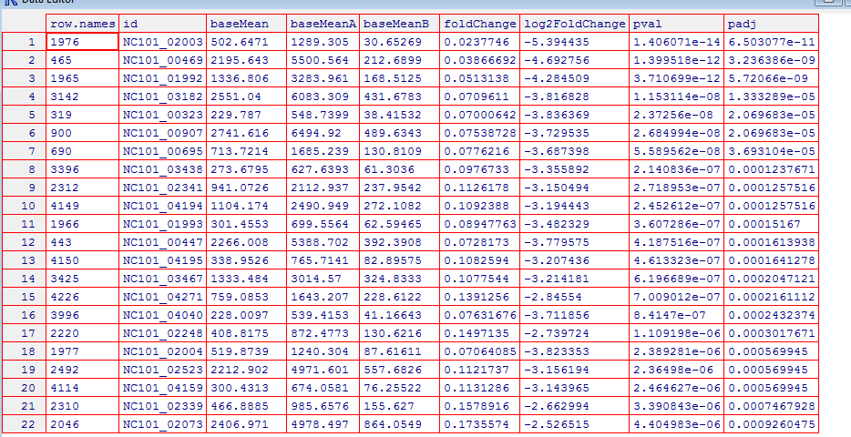
Here are example results from DeSeq (a popular RNA-seq analysis tool)…
FDR adjusted
p-values..
Raw p-values
You can access BH FDR correction from r with p.adjust( uncorrectedPValues, method=“BH”)

